Slide 1
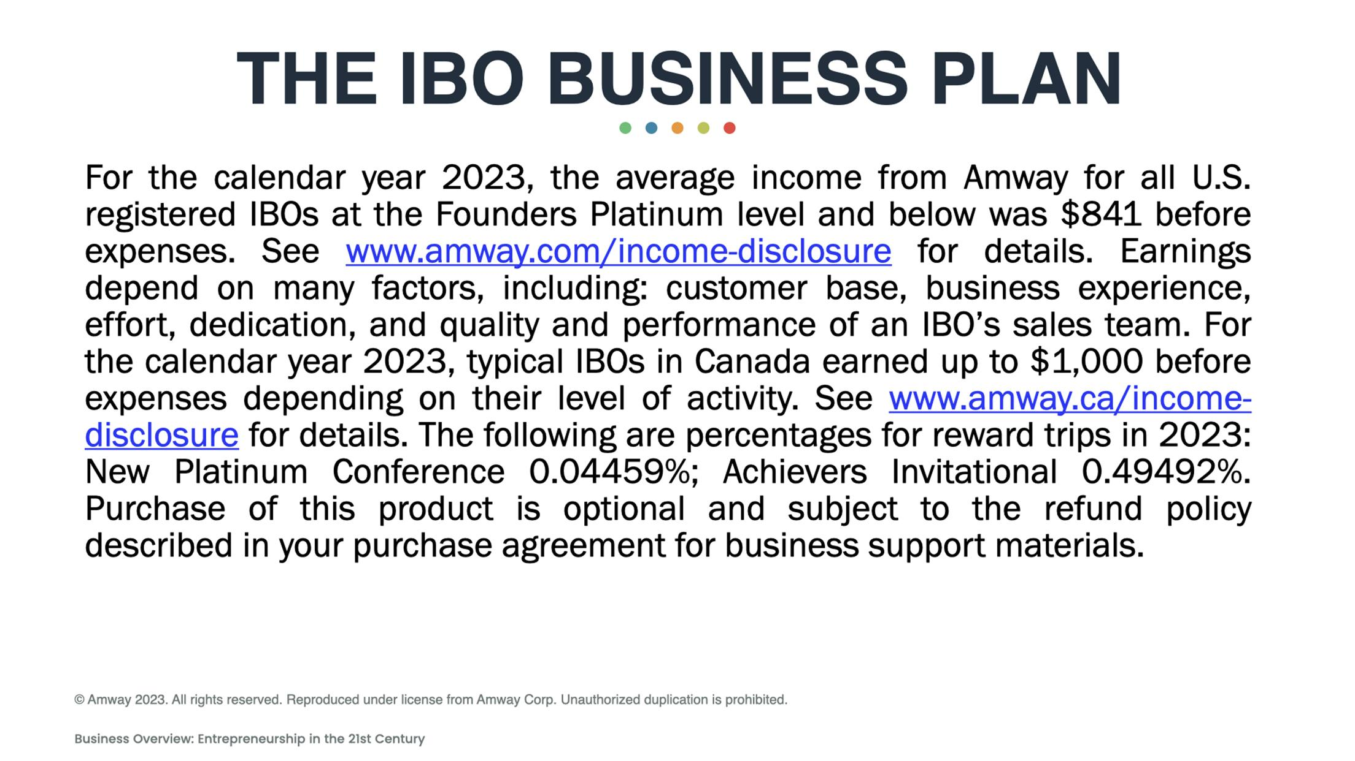

Slide 2

IMA 2025_1

Slide 3
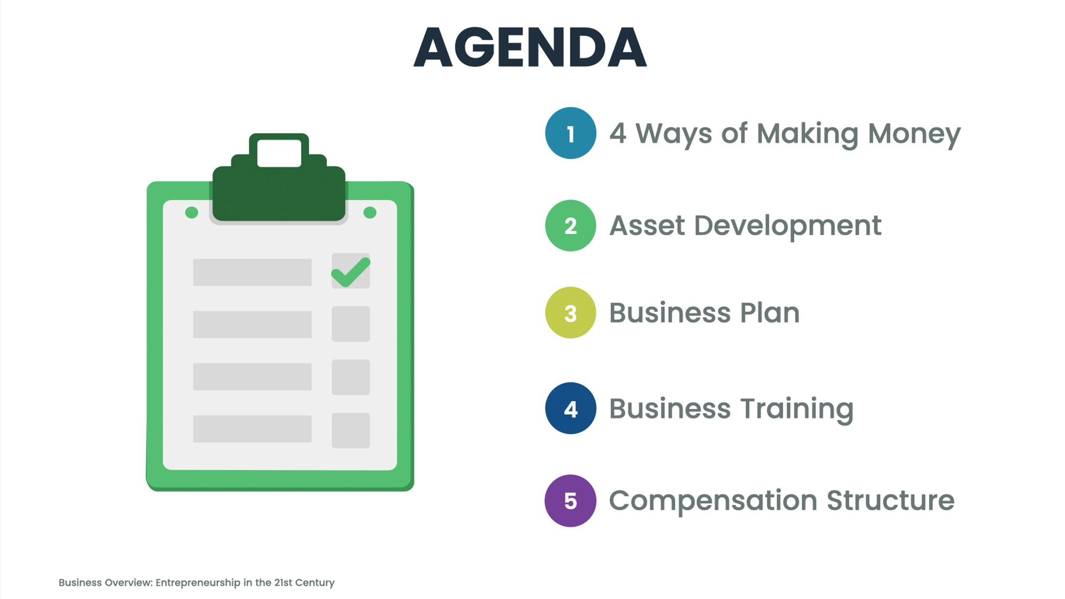

Slide 4
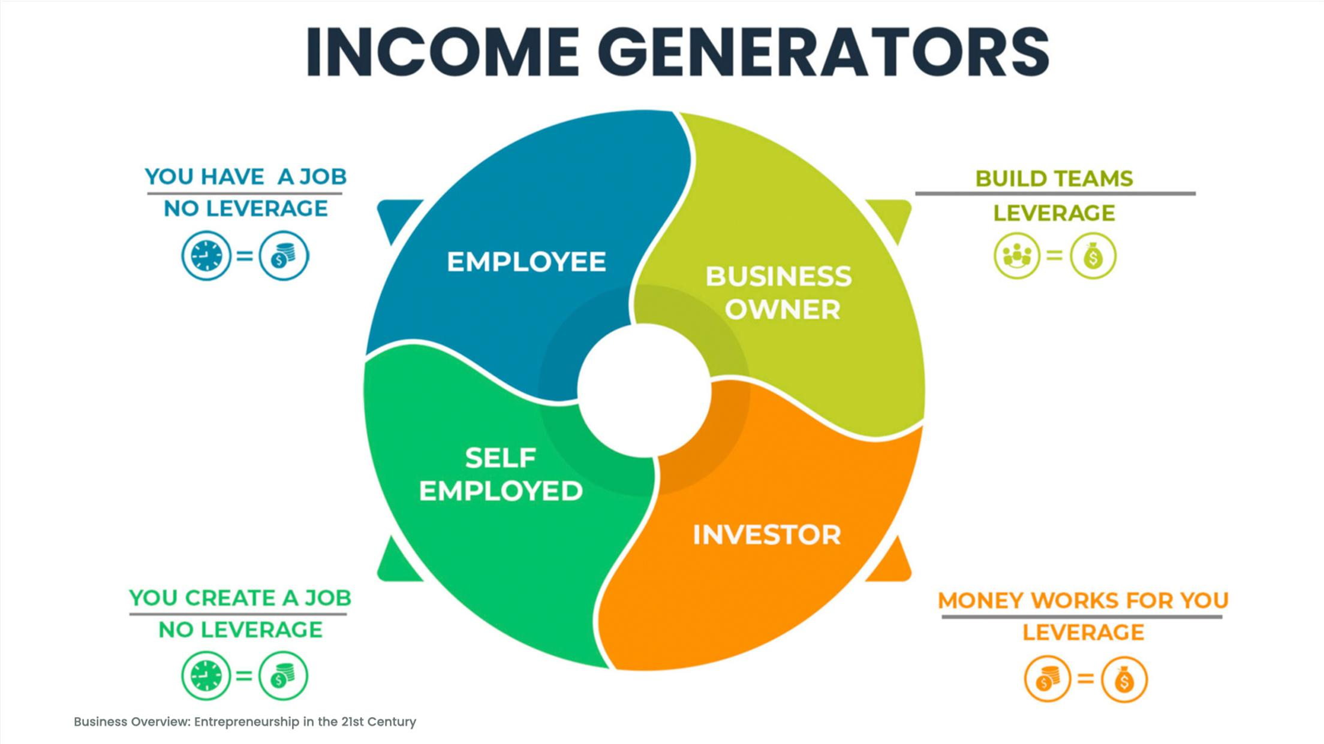

Slide 6
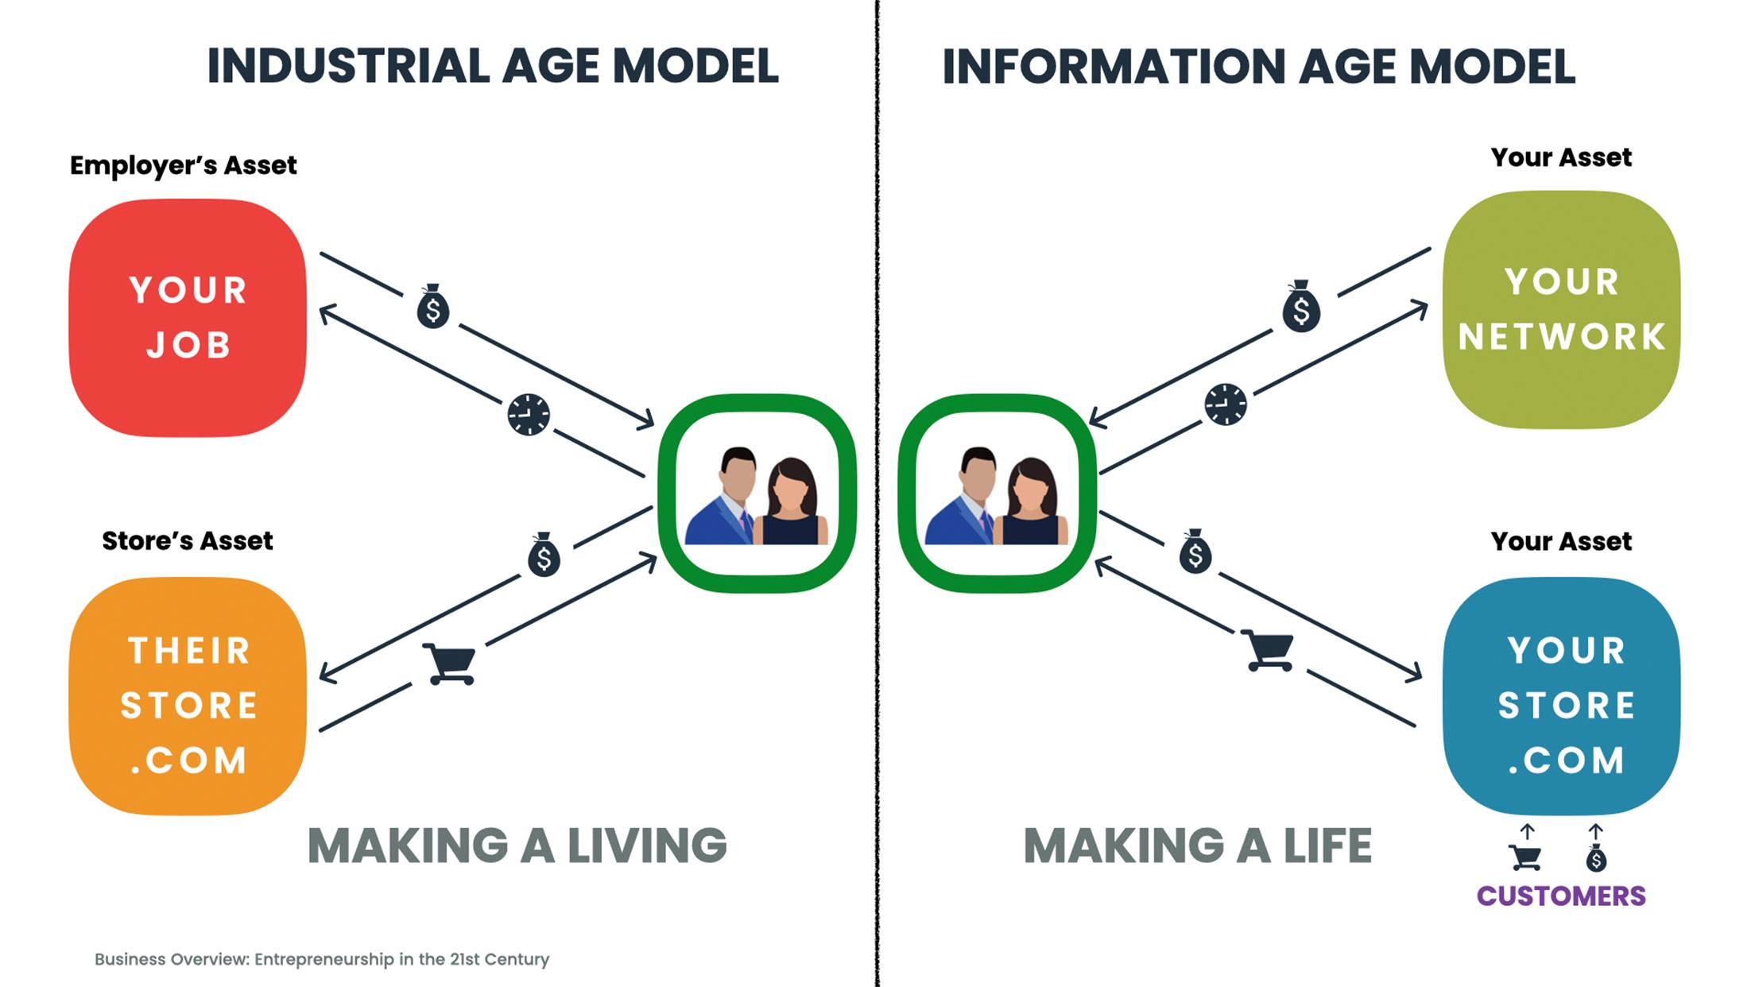

Slide 7


Slide 8


Slide 9


Slide 10

FROM MAJOR RETAILERS FOR BUSINESS OWNERS

Slide 11
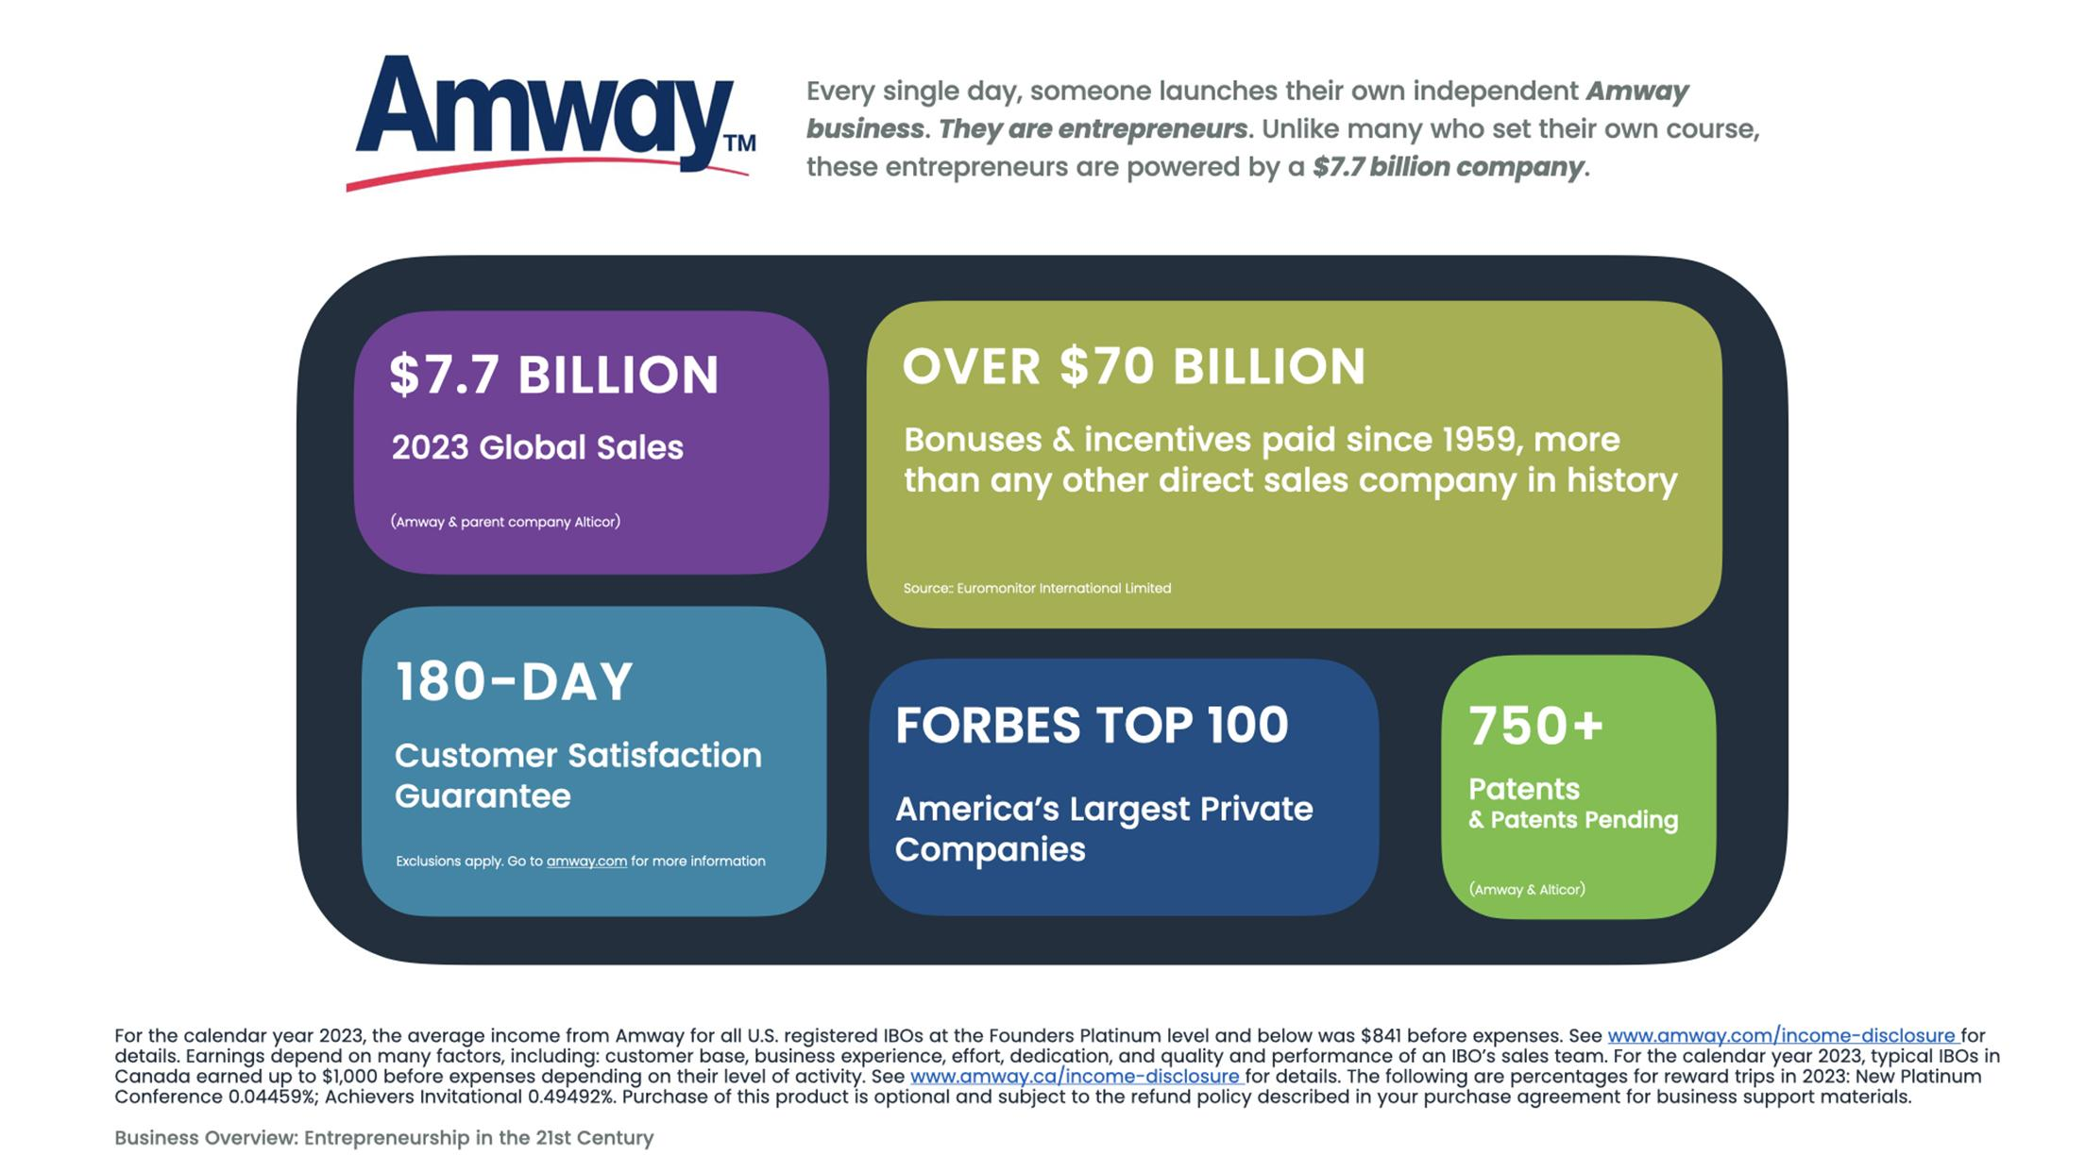

Slide 12
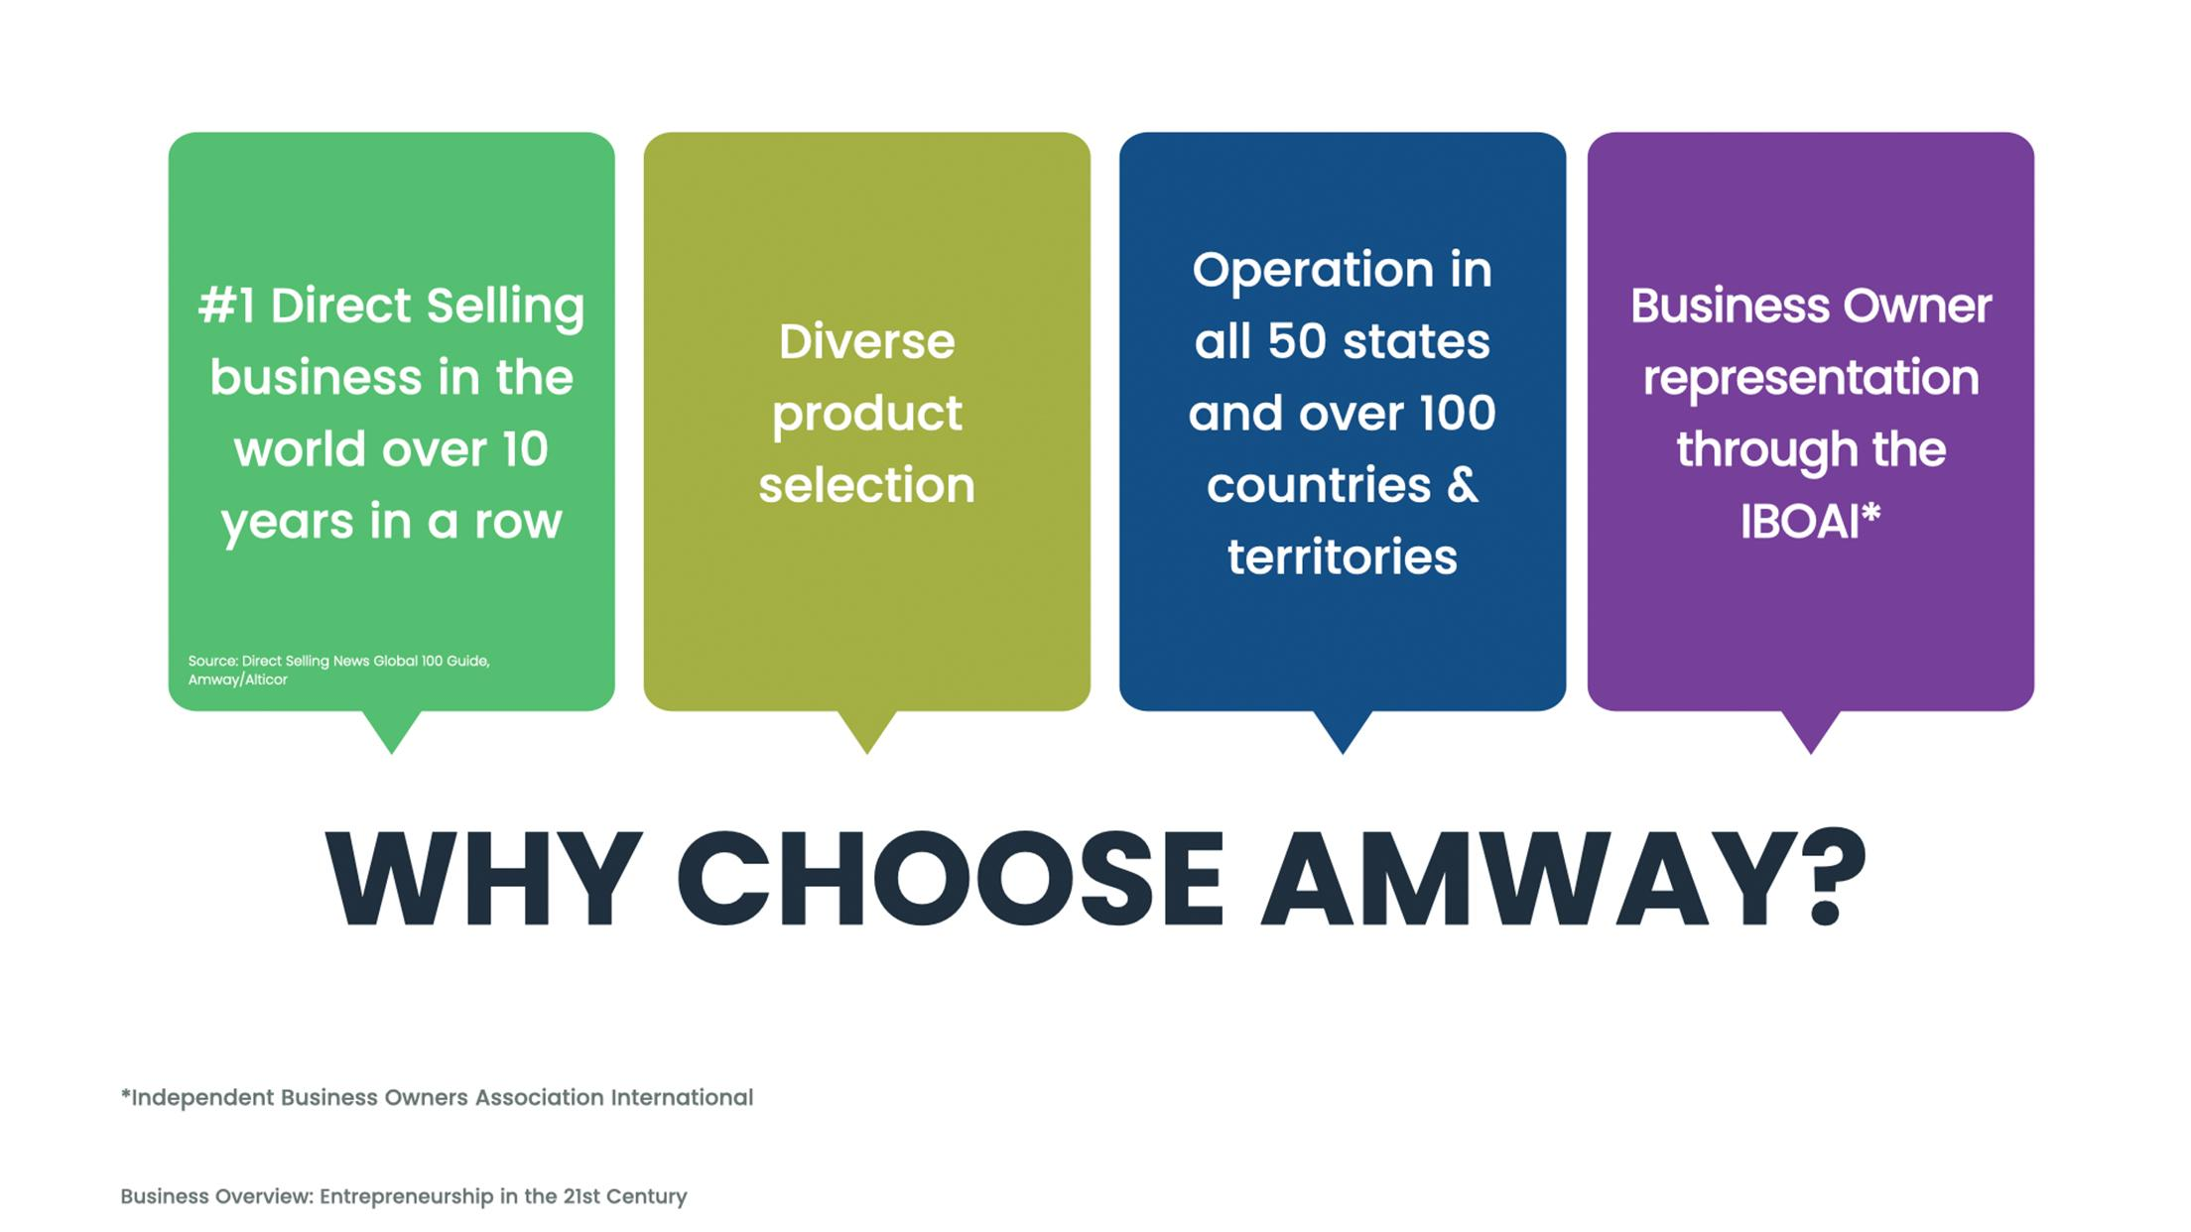

Slide 13
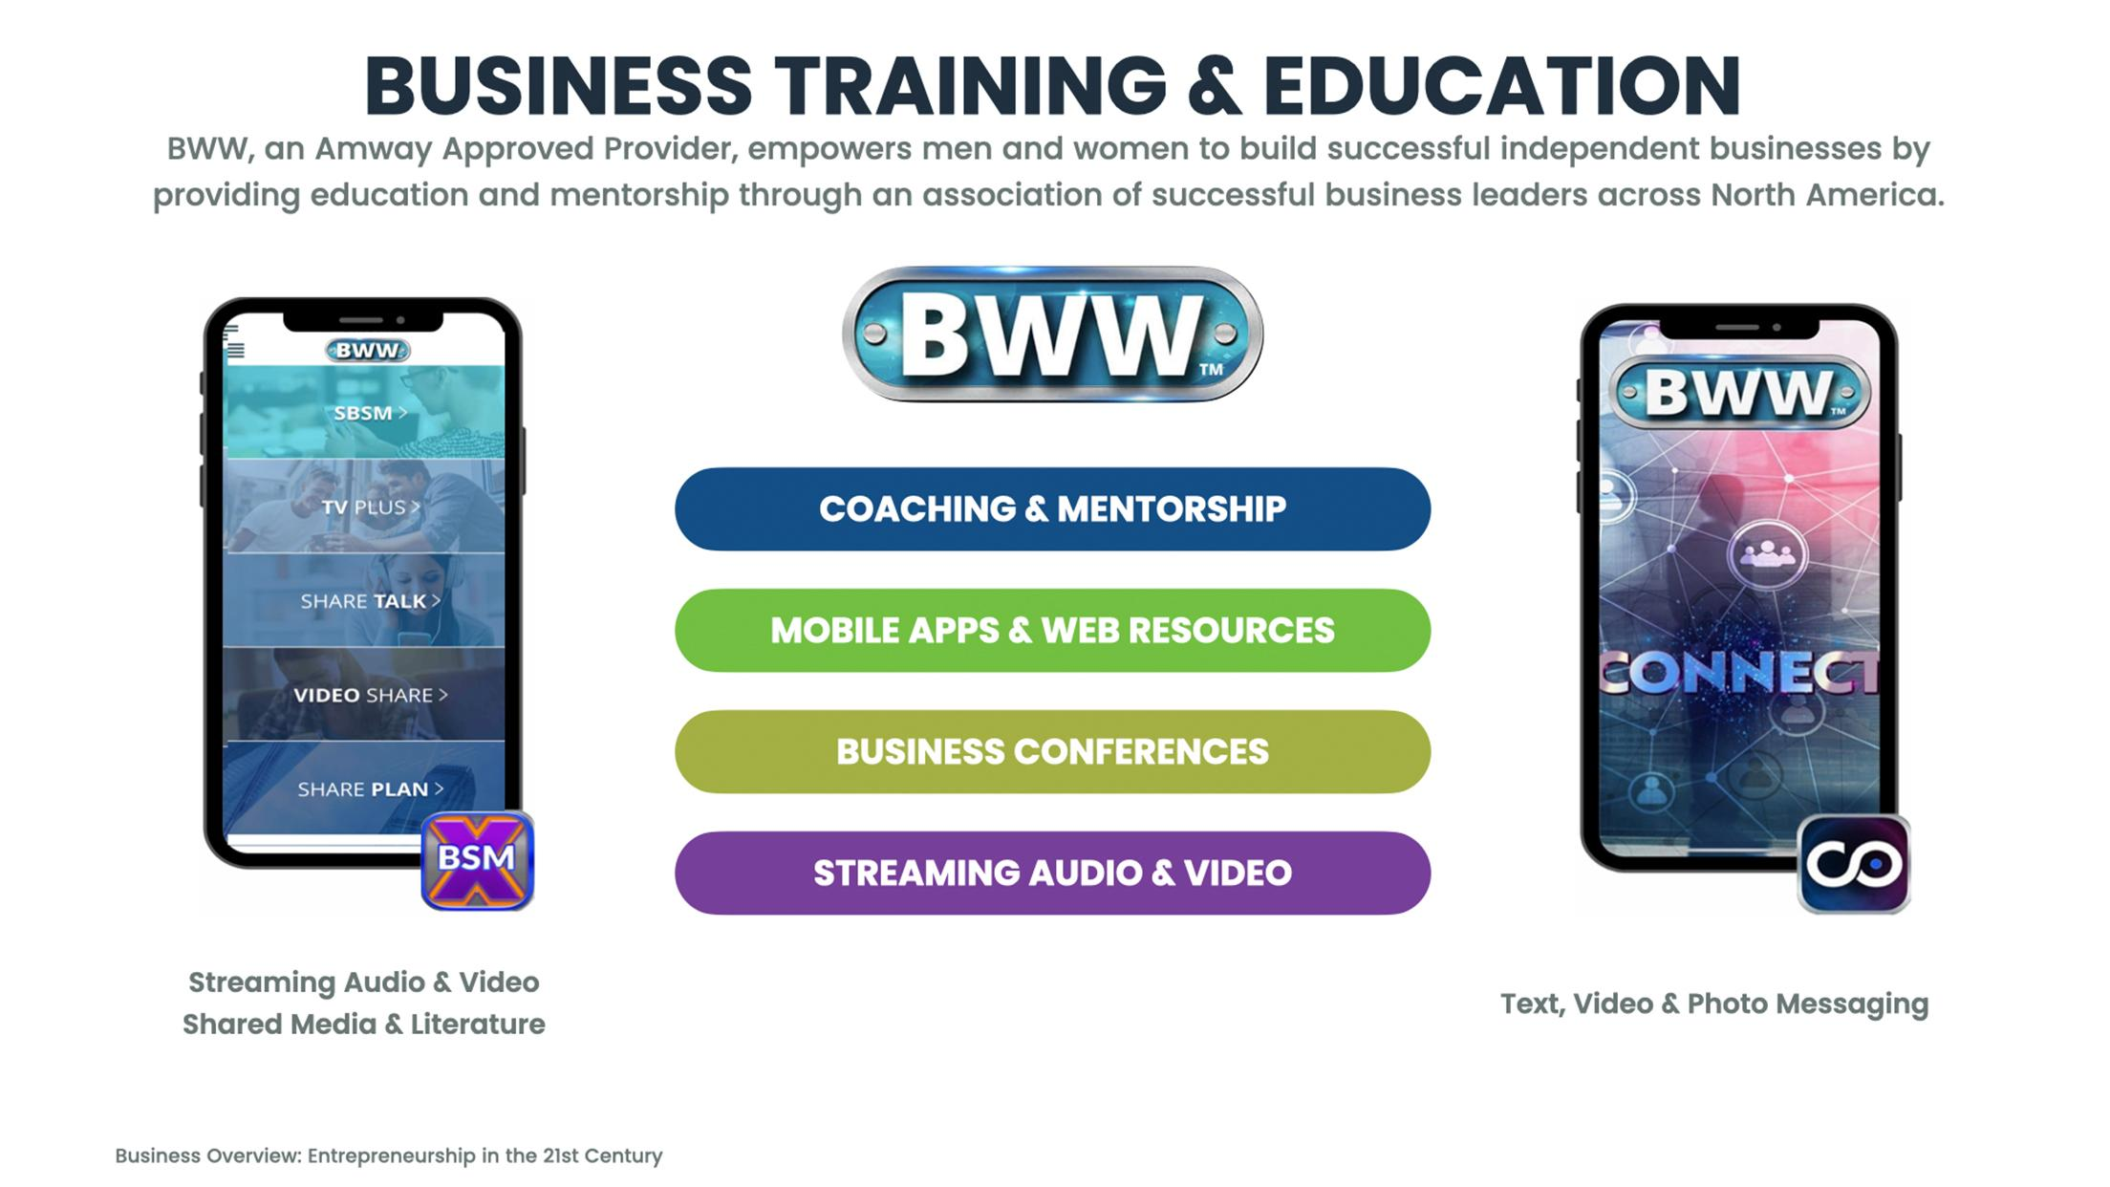

Slide 14



Slide 15
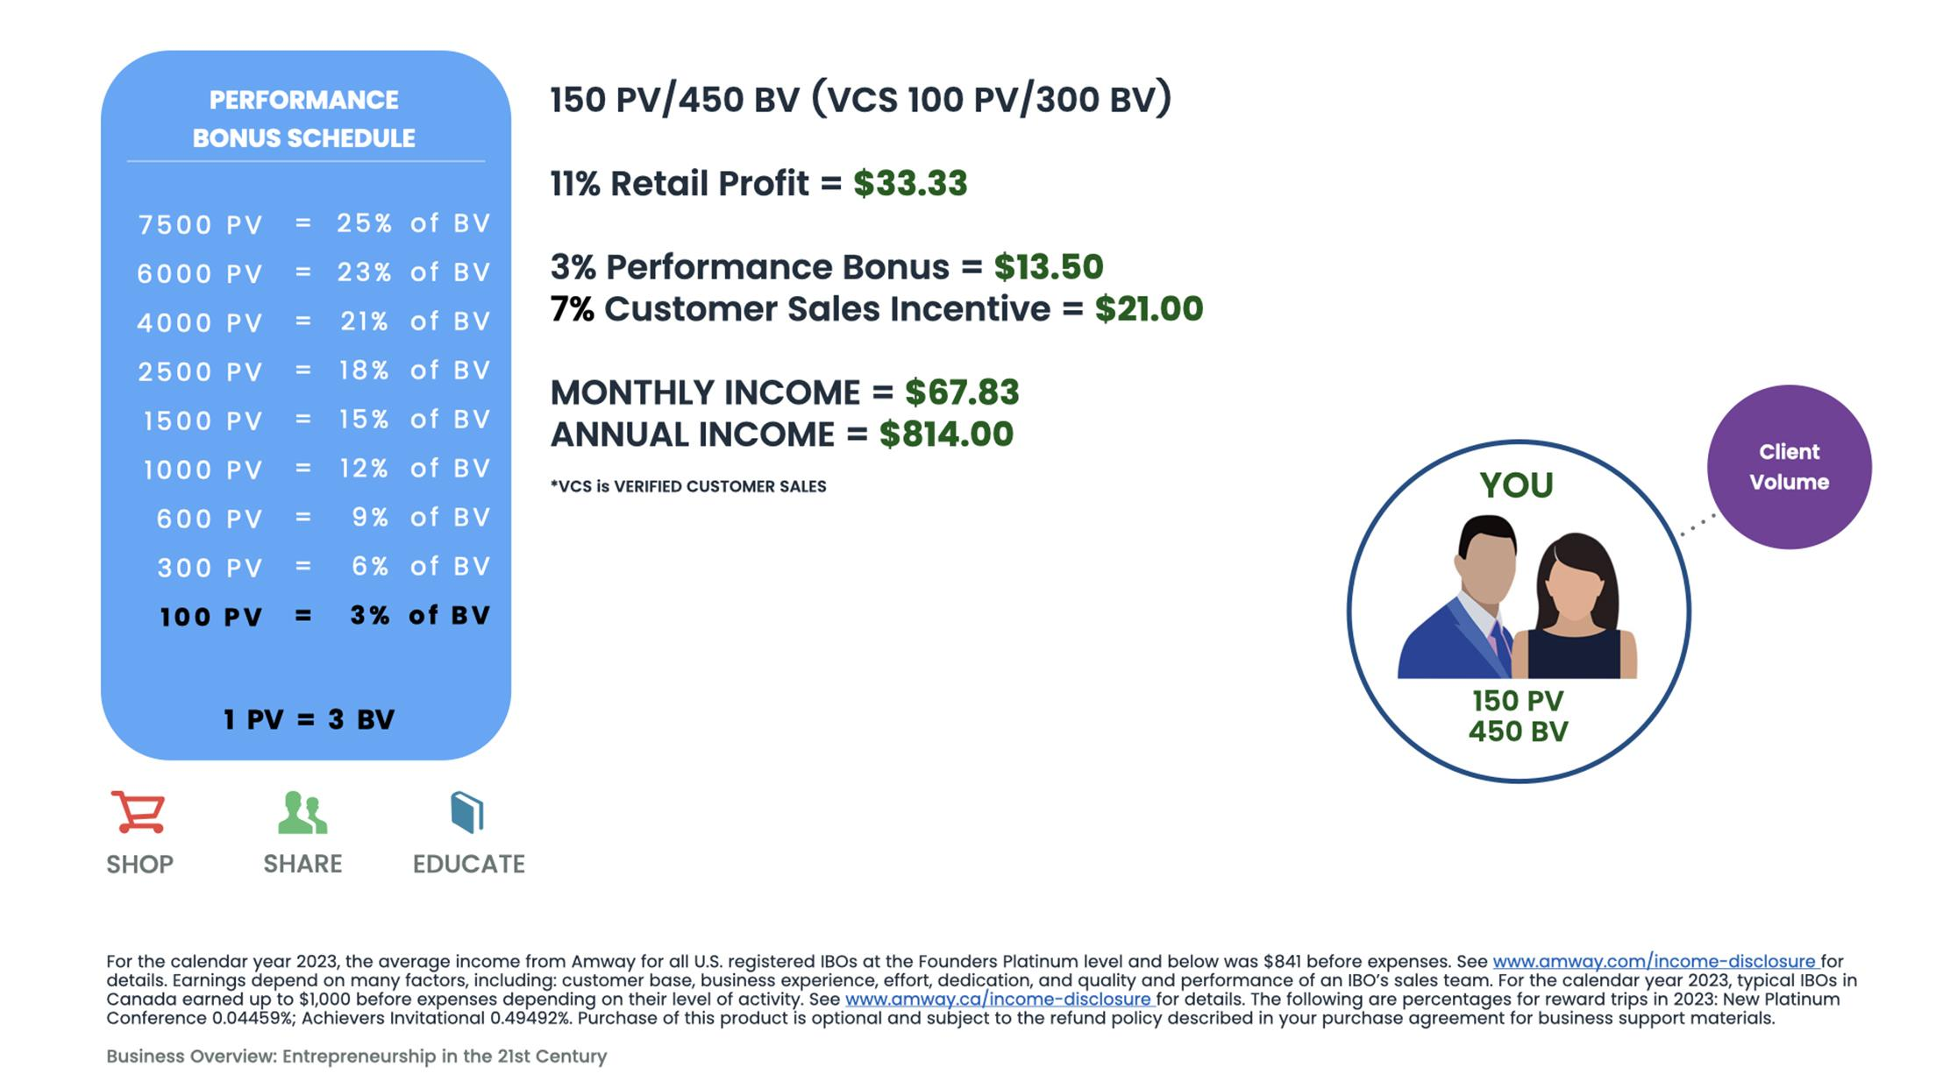

Slide 16
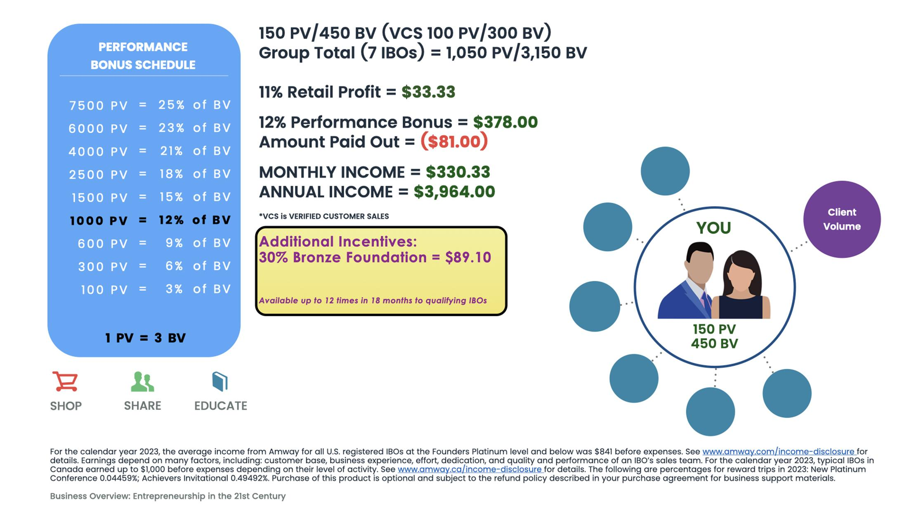

Slide 17
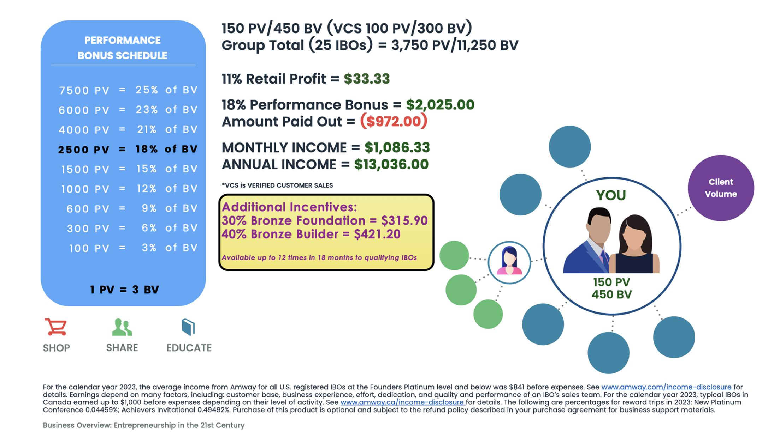

Slide 18
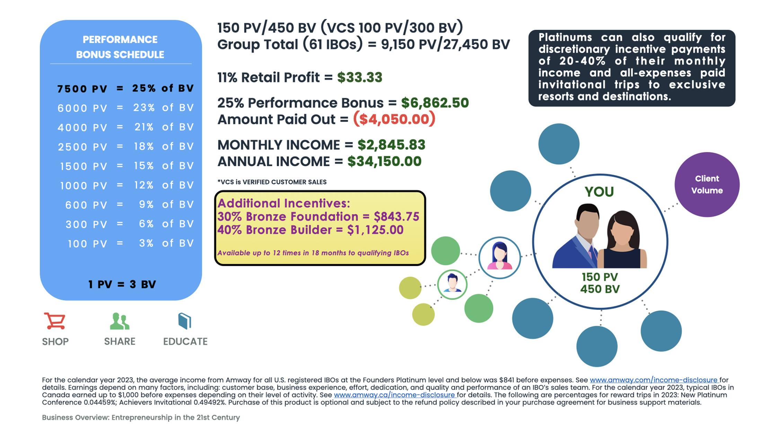

Slide 19
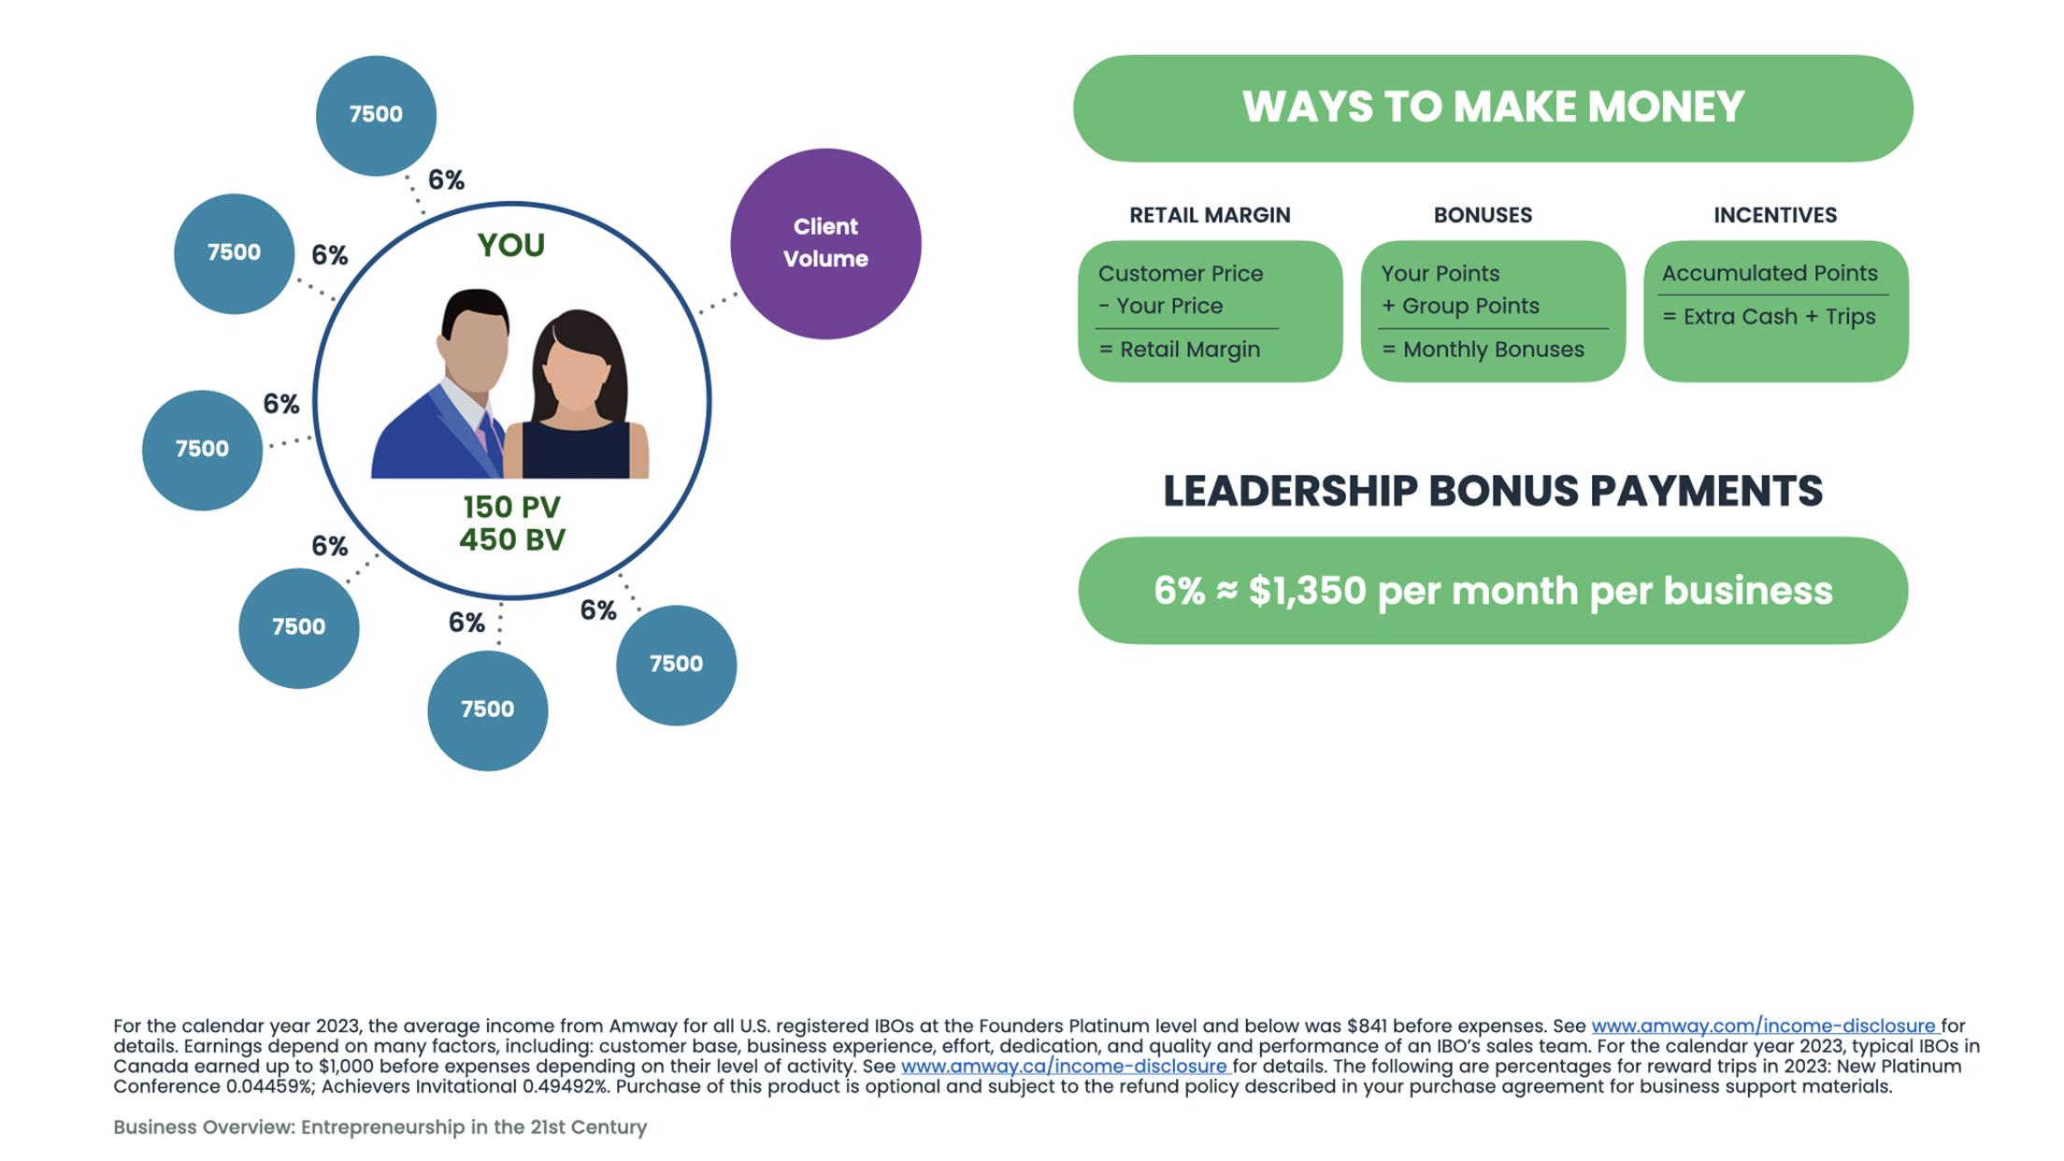

Slide 20


Slide 21

BUILDING SUCCESS
W I L L I N G N E S S TO A C C E P T C O A C H I N G

Slide 22


